Slide 1
Analyzing the Unemployment Rates Between Males and Females
This presentation will delve into the pressing issue of gender-based differences in unemployment rates, shedding light on the challenges faced by various genders in the job market.

Slide 2
Understanding the Labor Force
The labor force refers to the total number of people who are either employed or actively seeking employment. It includes individuals who are currently working as well as those who are looking for job opportunities.

Slide 3
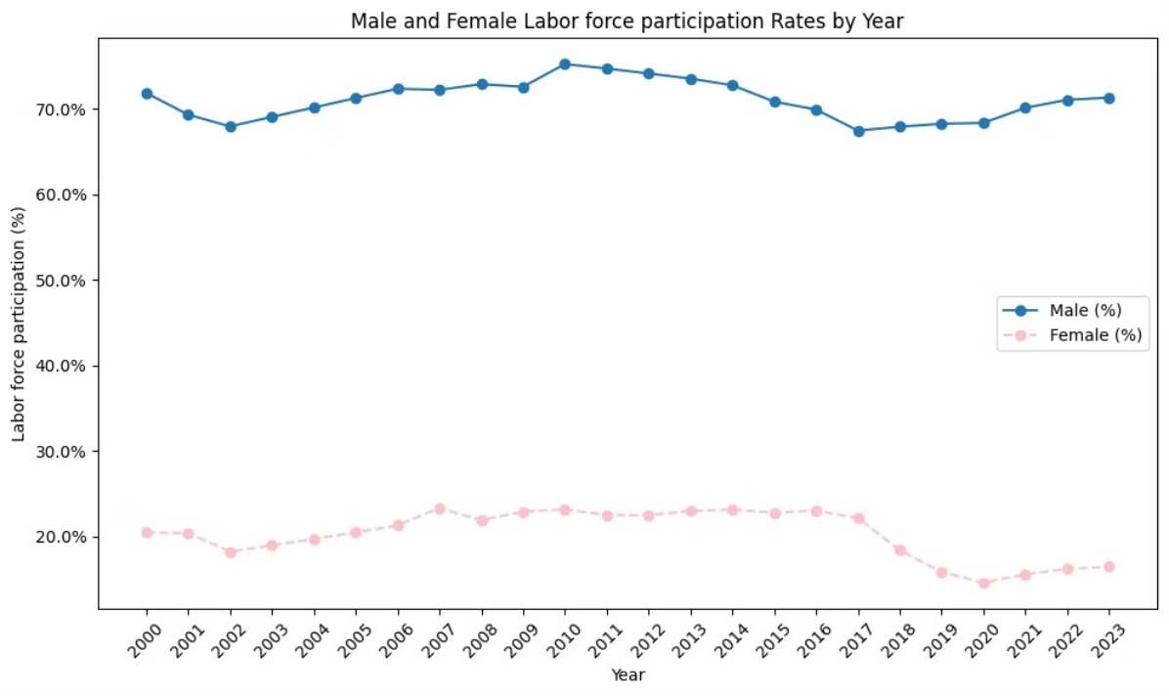
Labor Force Participation

Slide 4
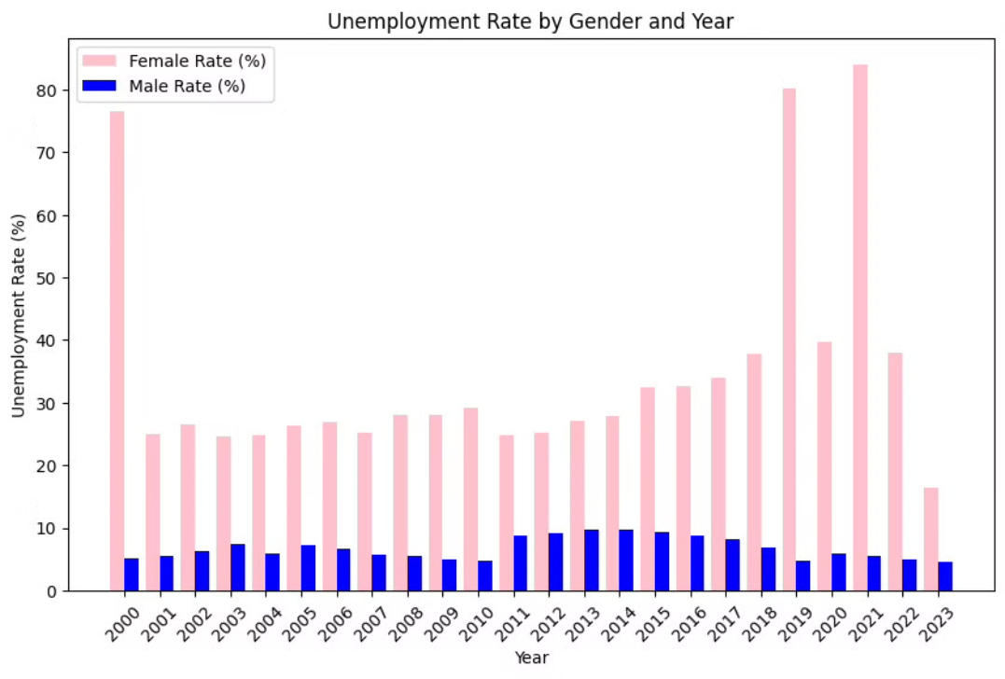
Exploring Unemployment Disparities

Slide 5
Reasons Of Unemployment Difference

Slide 6
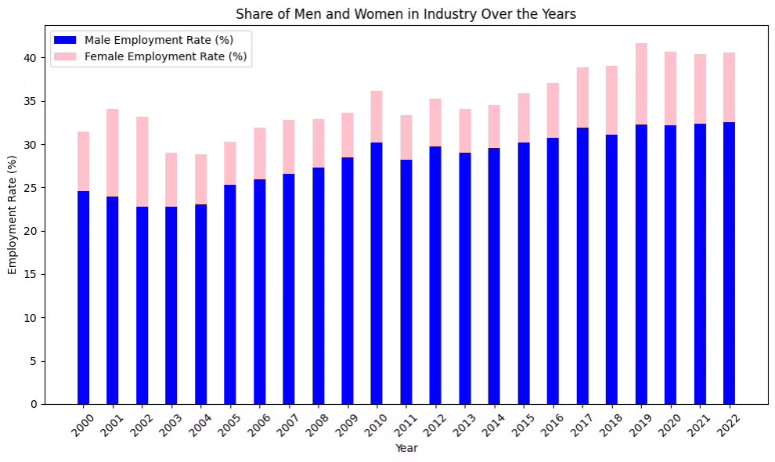
Industrial Composition

Slide 7
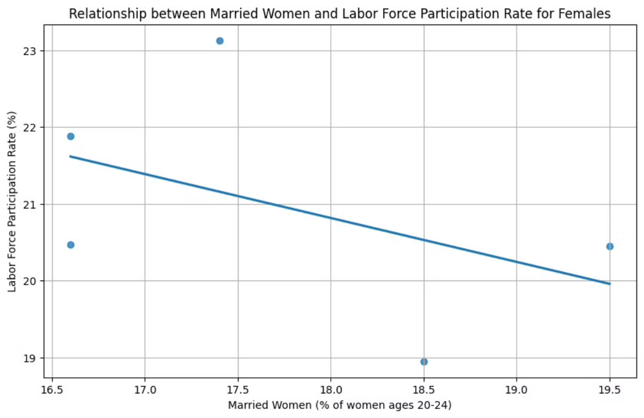
Marriage And Labor Participation

Slide 8
Conclusion
In conclusion, our analysis underscores the critical importance of addressing gender disparities in unemployment rates as a fundamental step towards achieving economic and social equality. Despite encountering challenges related to data availability and granularity, our findings highlight a significant correlation between gender and unemployment rates, emphasizing the need for targeted interventions to promote gender equity in the labor market.

